Slide 1


1
ROAD SIGN DETECTION USING MACHINE LEARNING IN CNN
By:
Mohamed Thoufik U
Sundaramanickam N
Thamij Ahamed M
811720104069
811720104107
811720104113
Guided By:
Mrs.R.Sathya M.E.,(Ph.D)

Slide 2
2
CONTENTS
Objectives
Literature Survey
Problem Statement
Existing System
Proposed System
Architecture

Slide 3
3
OBJECTIVES
To Develop and implement a robust machine learning model capable of accurately detecting and classifying various types of road signs from images.
To enhance autonomous driving systems, improve road safety, and assist in real-time navigation for drivers.
Explore common challenges in detecting road signs in real-world scenarios (e.g., lighting conditions, occlusion, and variations in sign design)

Slide 4
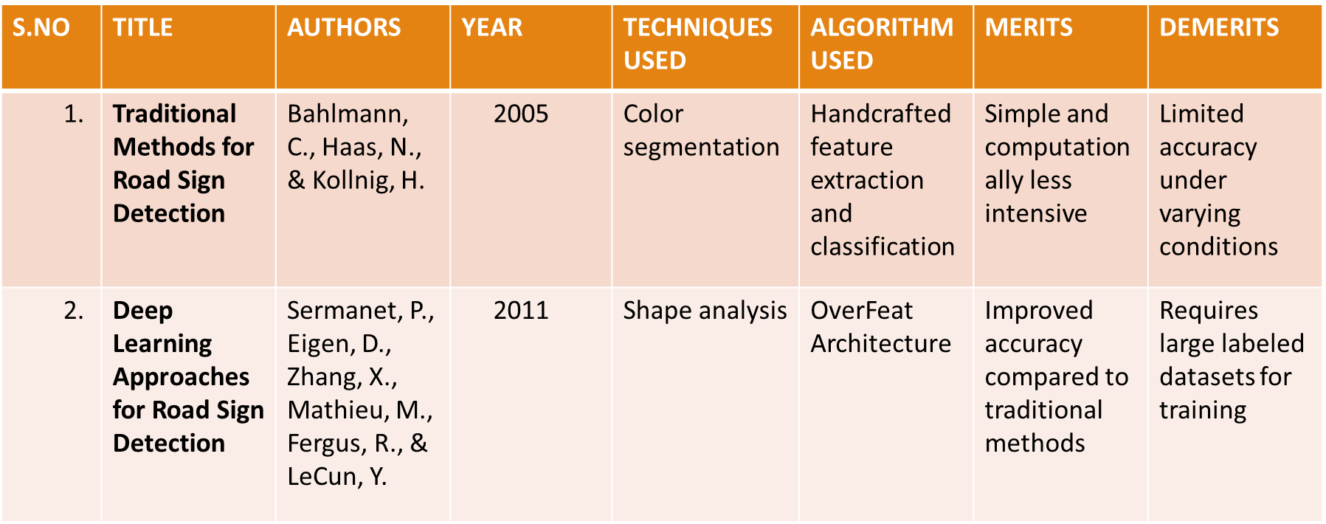
6
LITERATURE SURVEY

Slide 5
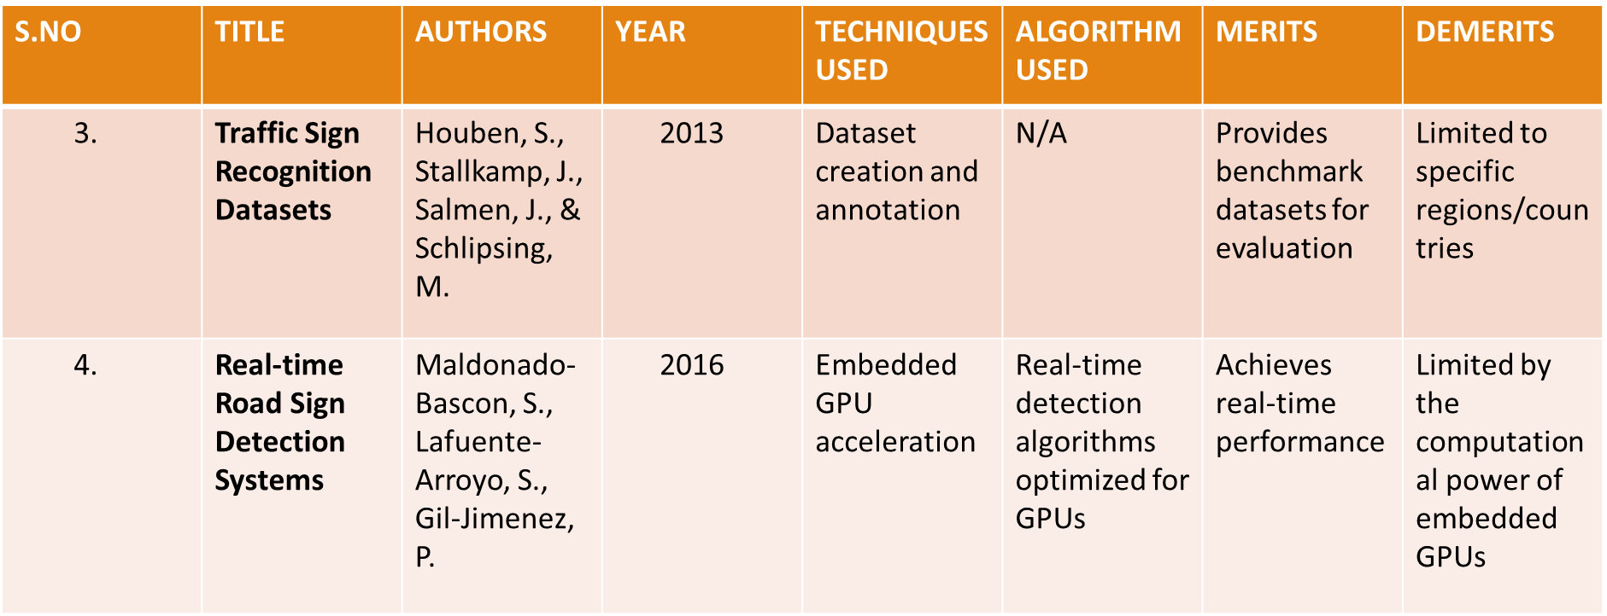
7
LITERATURE SURVEY

Slide 6
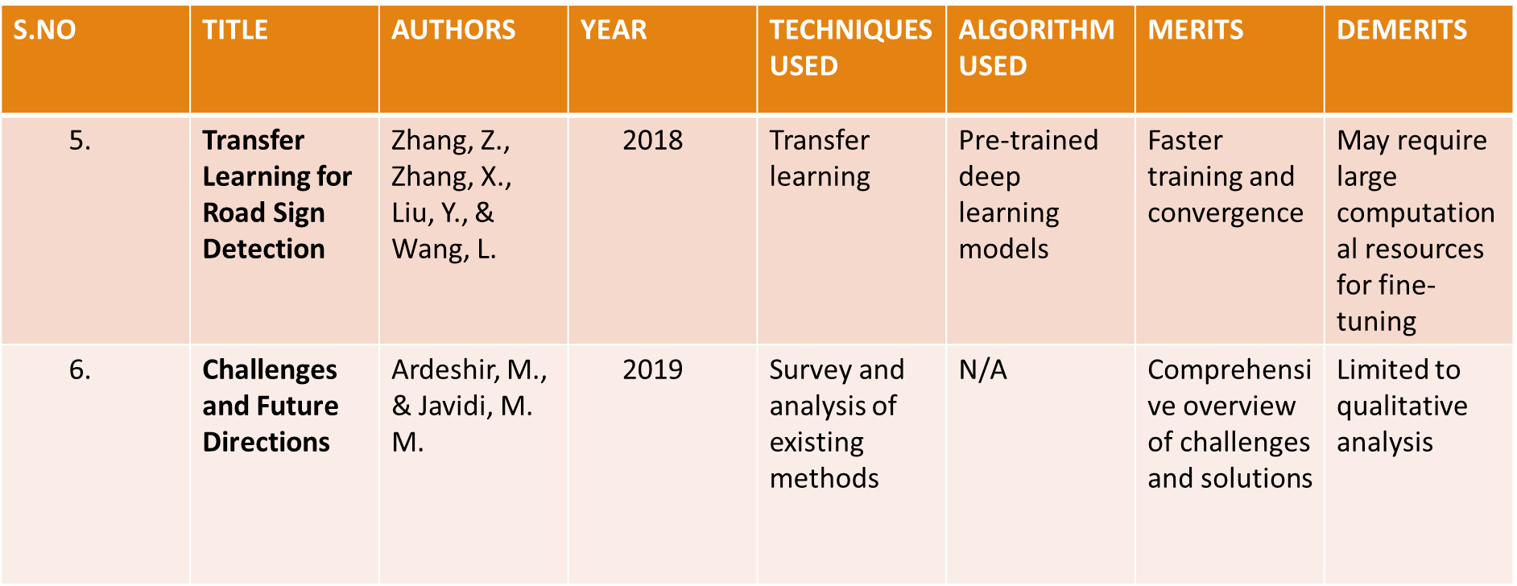
LITERATURE SURVEY

Slide 7
4
PROBLEM STATEMENT
In the context of modern transportation and autonomous driving systems, there exists a critical need for accurate and efficient road sign detection and classification.
Despite advancements in computer vision, the detection of road signs under varying lighting conditions, weather, and occlusions remains a challenging task.
Develop a machine learning model to accurately detect and classify road signs from images in real-time.

Slide 8
5
EXISTING SYSTEMS
In the existing system, road sign detection is primarily based on traditional computer vision techniques, which often lack accuracy and robustness under varying conditions.
These methods typically involve handcrafted features, such as color, shape, and texture, followed by classification using machine learning algorithms.
The limitations of the existing system include:
1.Limited Accuracy
2.Performance
3.Scalability

Slide 9
8
PROPOSED SYSTEM
The proposed system aims to leverage the power of deep learning and convolutional neural networks (CNNs) to overcome the limitations of the existing system.
The key features and improvements of the proposed system are:
1.Deep Learning-based Detection
2.Multi-class Classification
3.User-Friendly Interface

Slide 10
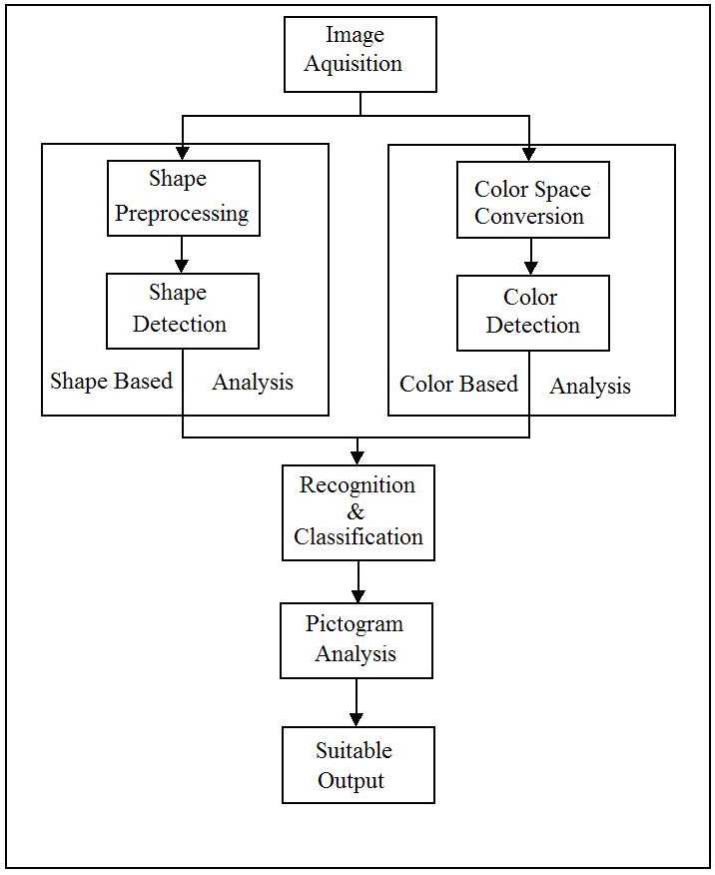
9
ARCHITECTURE

Slide 11
Modules
1.Sensors for Road Detection
2.Techniques and Algorithm
3.Challenges in Road Sign Detection
4.Application
5.Techniques for improvement

Slide 12
SAMPLE CODE
import tkinter as tk
from tkinter import filedialog
from tkinter import
from PIL import ImageTk, Image
import numpy
#load the trained model to classify sign
from keras.models import load_model
model = load_model('traffic_classifier.h5')
#dictionary to label all traffic signs class.
classes = { 1:'Speed limit (20km/h)',
2:'Speed limit (30km/h)',
3:'Speed limit (50km/h)',
4:'Speed limit (60km/h)',
5:'Speed limit (70km/h)',
6:'Speed limit (80km/h)',
7:'End of speed limit (80km/h)',

Slide 13
8:'Speed limit (100km/h)',
9:'Speed limit (120km/h)',
10:'No passing',
11:'No passing veh over 3.5 tons',
12:'Right-of-way at intersection',
13:'Priority road',
14:'Yield',
15:'Stop',
16:'No vehicles',
17:'Veh > 3.5 tons prohibited',
18:'No entry',
19:'General caution',
20:'Dangerous curve left',
21:'Dangerous curve right',
22:'Double curve',
23:'Bumpy road',
24:'Slippery road',
25:'Road narrows on the right',
26:'Road work’,

Slide 14
27:'Traffic signals',
28:'Pedestrians',
29:'Children crossing',
30:'Bicycles crossing',
31:'Beware of ice/snow',
32:'Wild animals crossing',
40
33:'End speed + passing limits',
34:'Turn right ahead',
35:'Turn left ahead',
36:'Ahead only',
37:'Go straight or right',
38:'Go straight or left',
39:'Keep right',
40:'Keep left',
41:'Roundabout mandatory',
42:'End of no passing',

Slide 15
THANK YOU

